Slide 1
Journal Club Gold Podocyte Disease
Thomas Oates PhD FRCP
Royal London Hospital
UKKW 2023

Slide 2
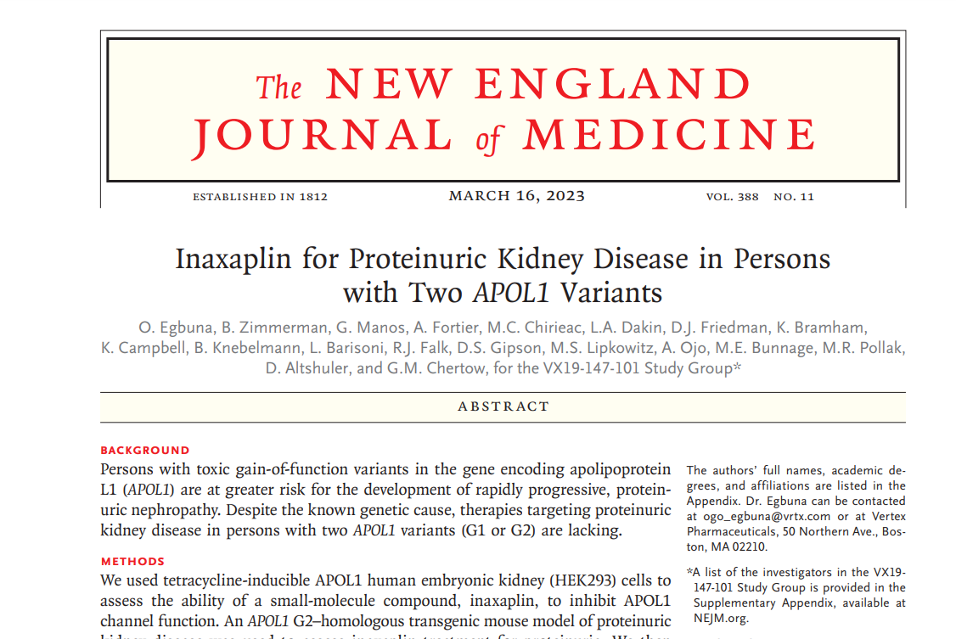

Slide 3

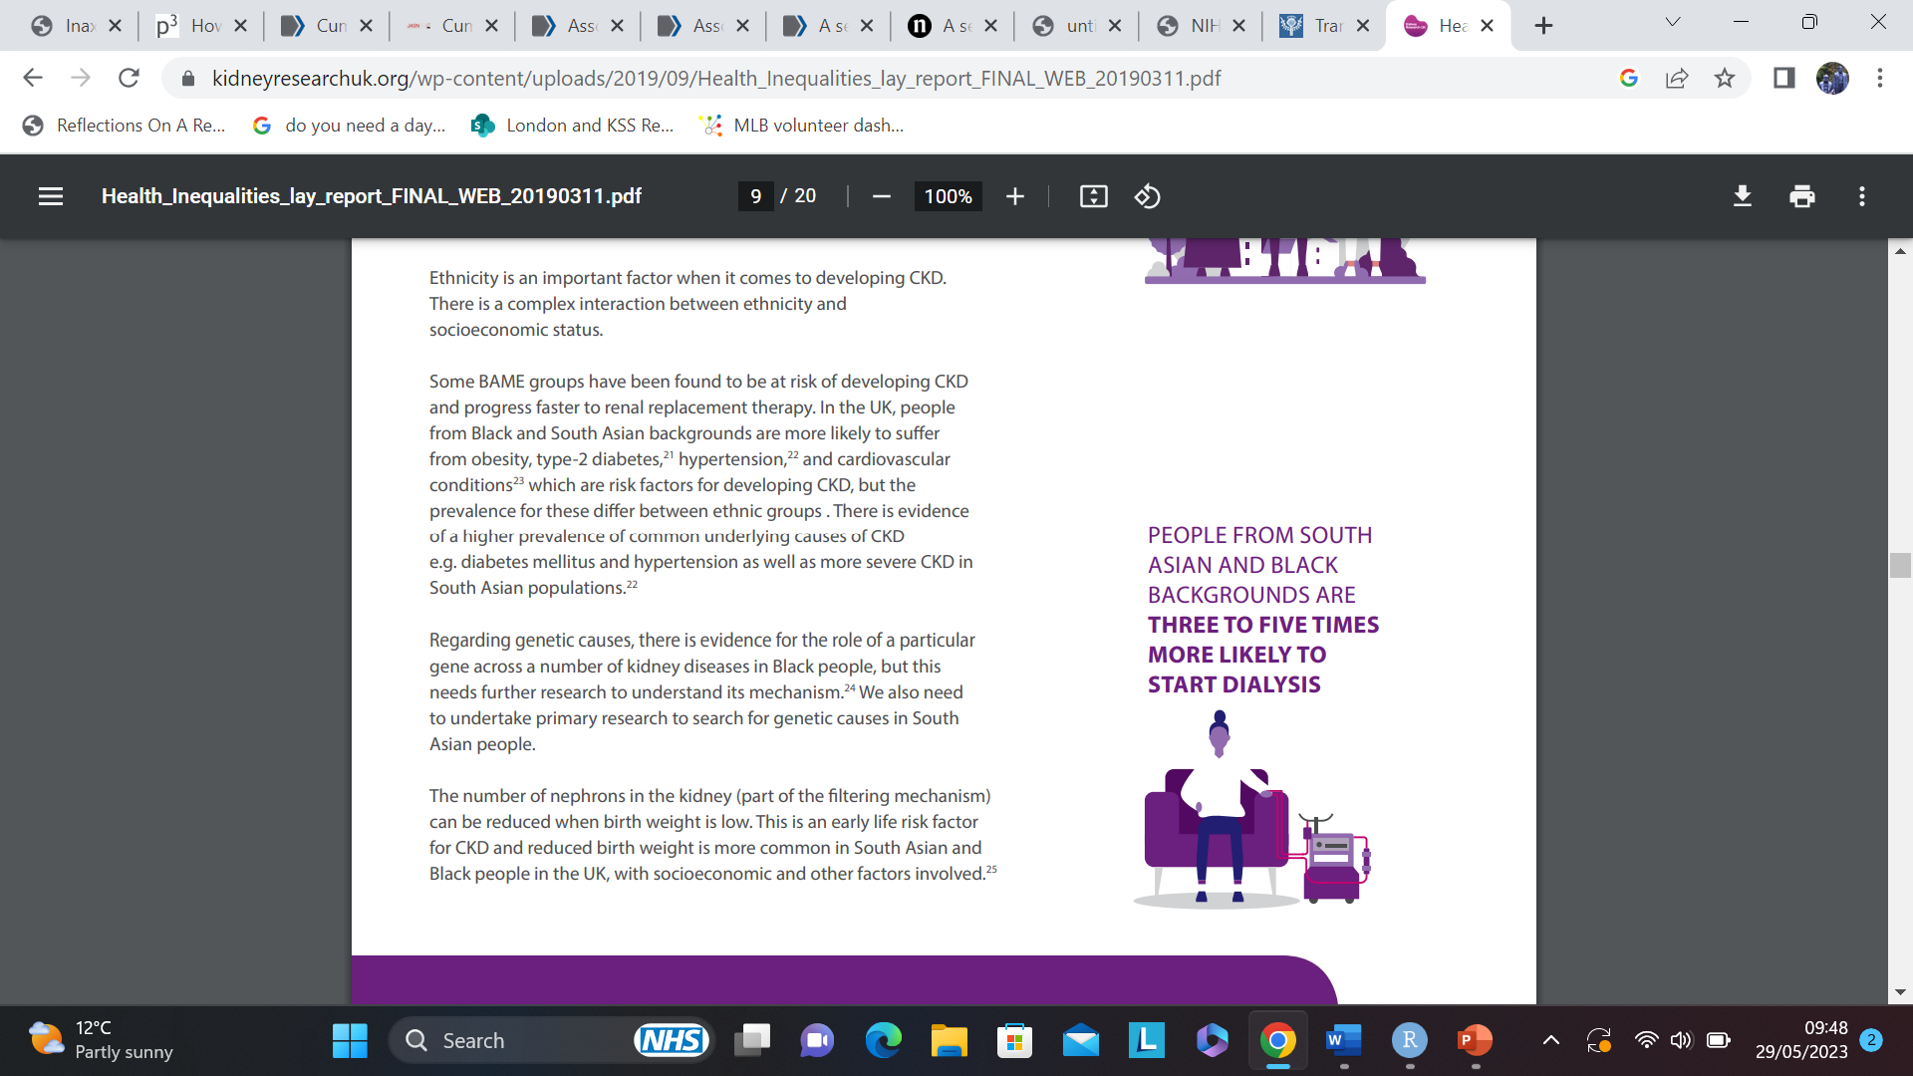
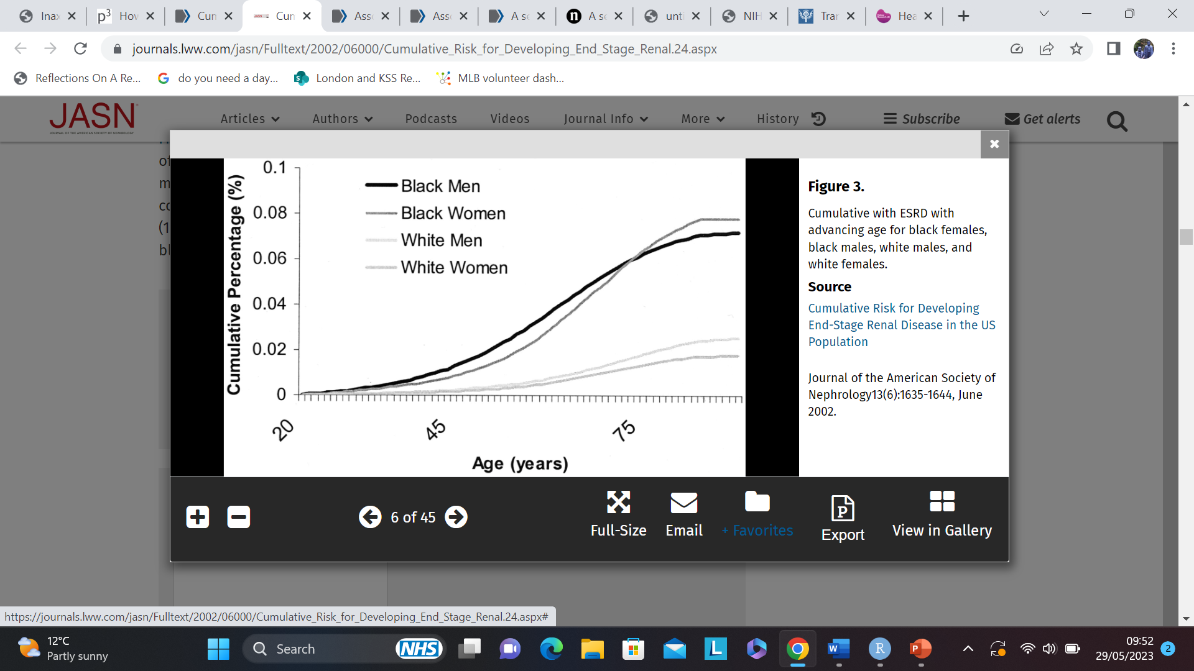
Kidney Health Inequalities
Kiberd & Clase, JASN, 2002
KRUK, Kidney Health Inequalities in the UK, 2018

Slide 4
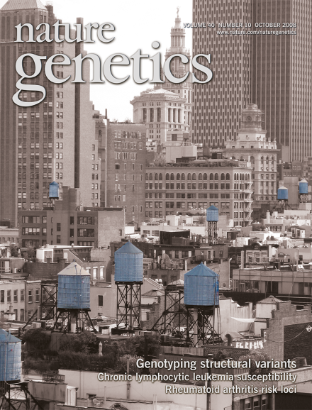
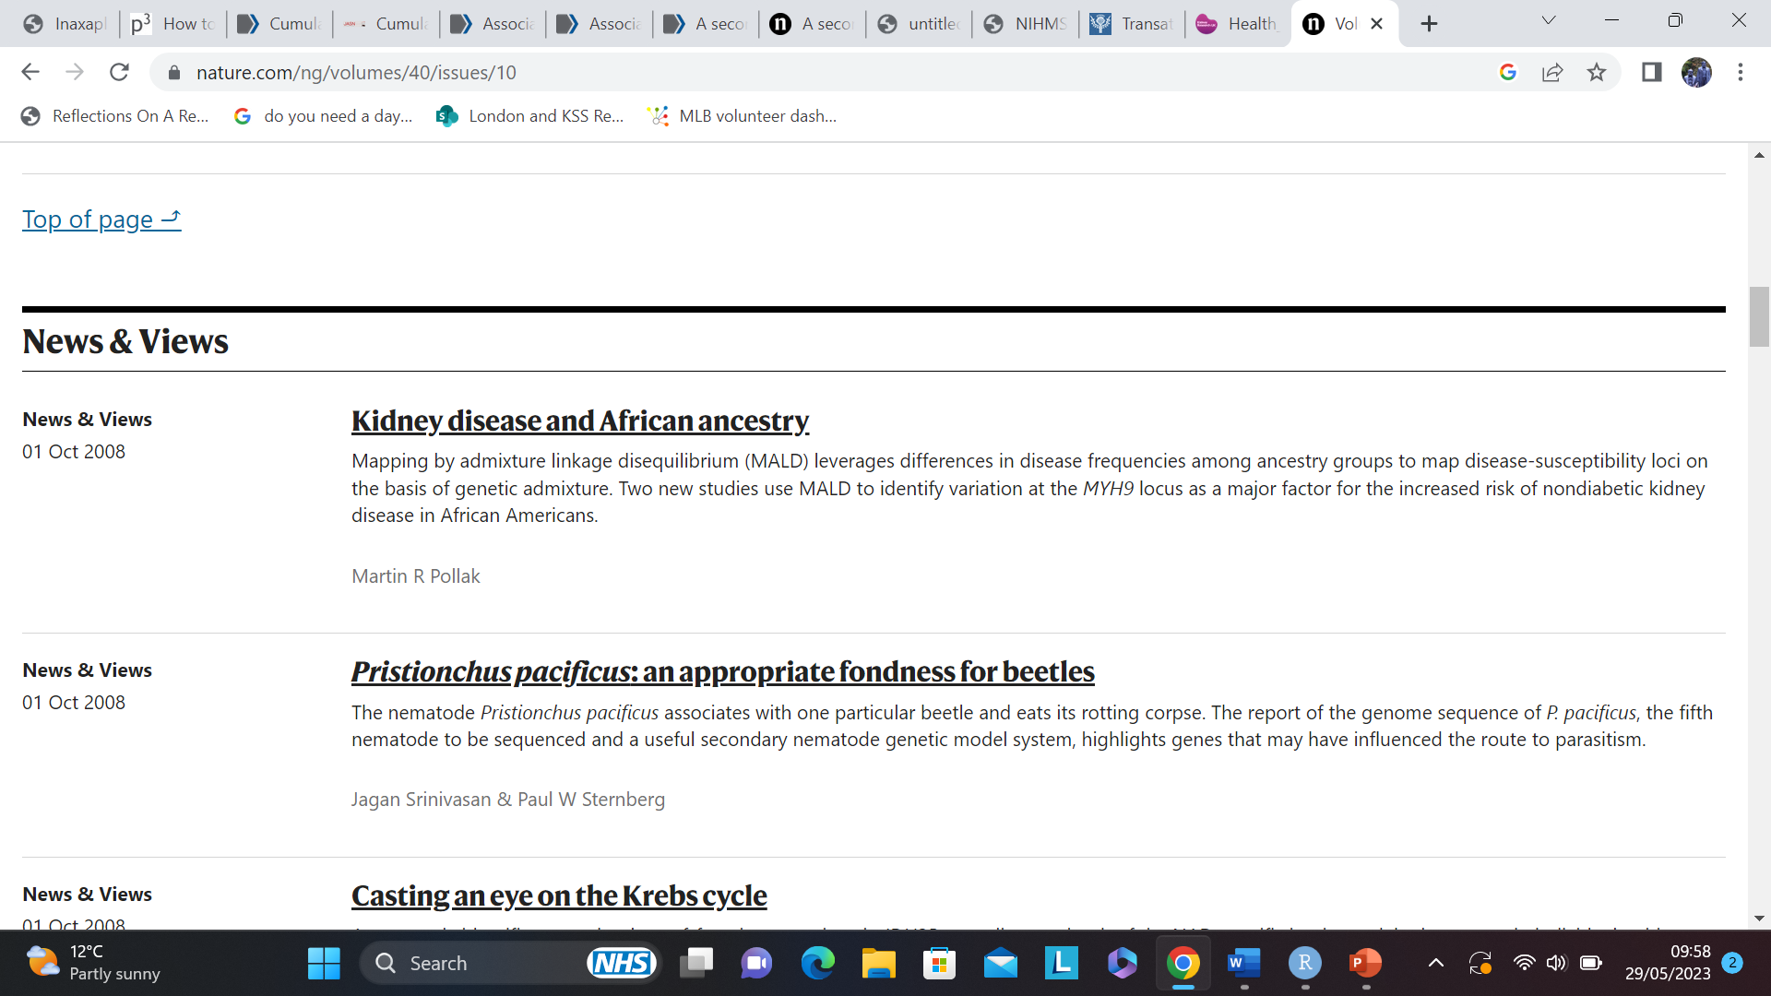
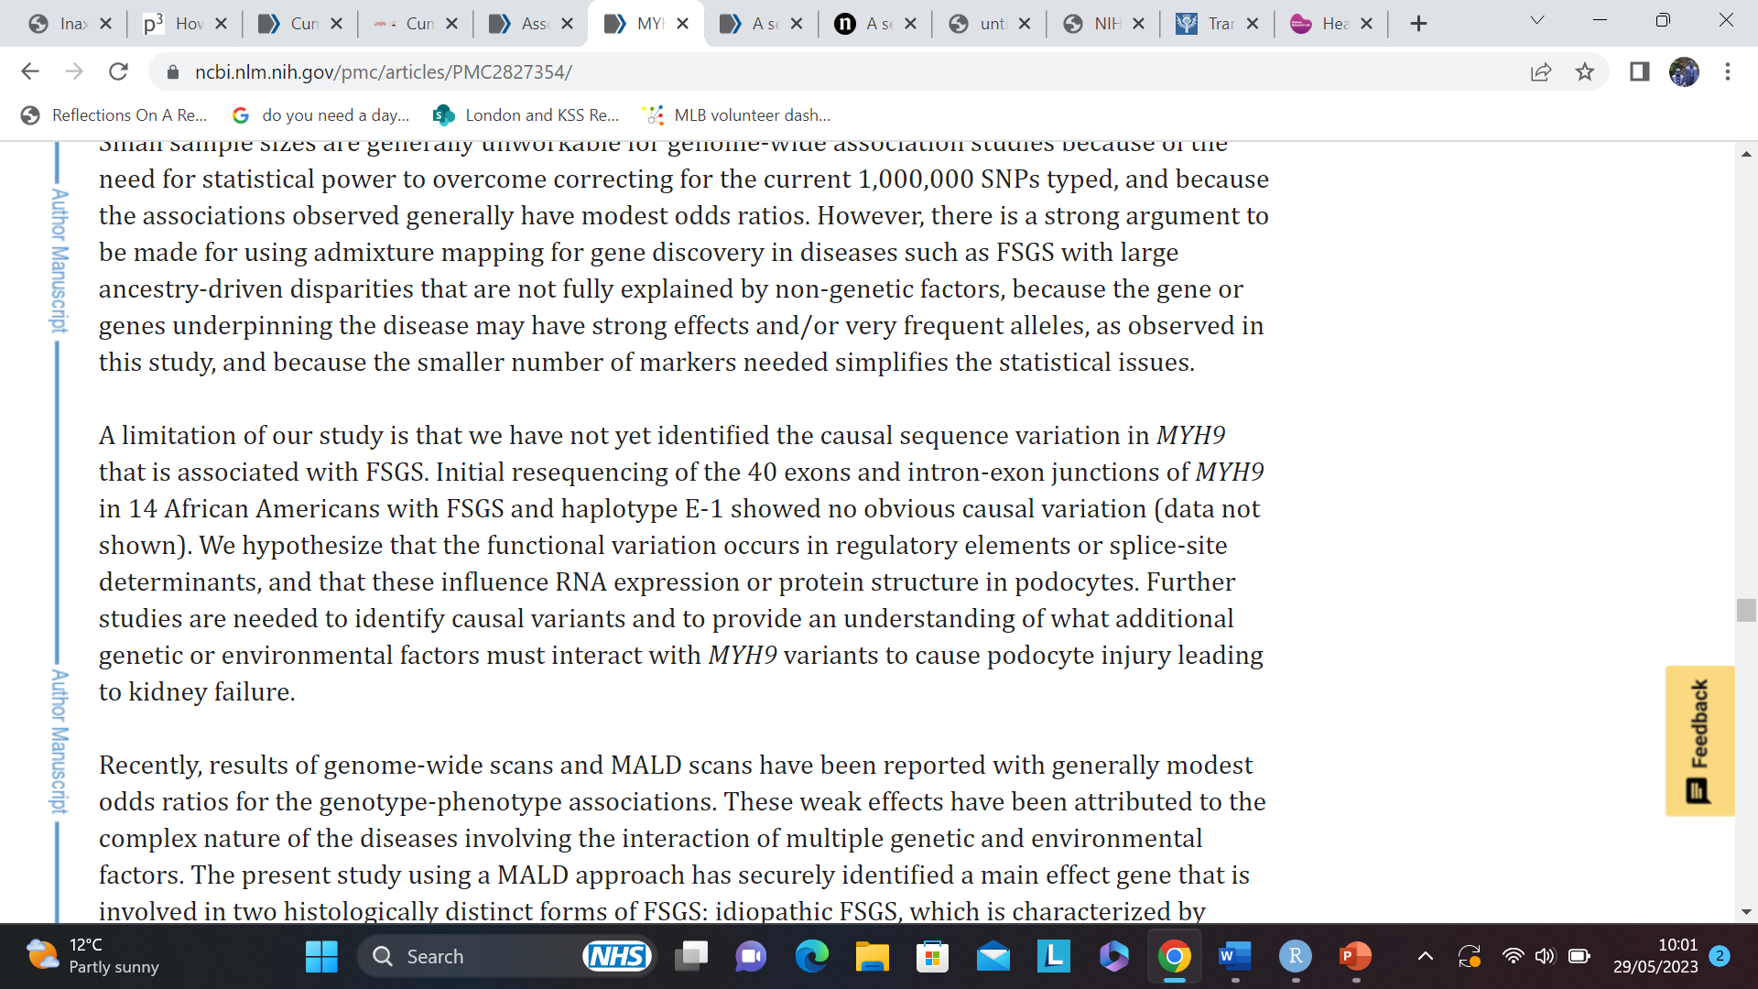
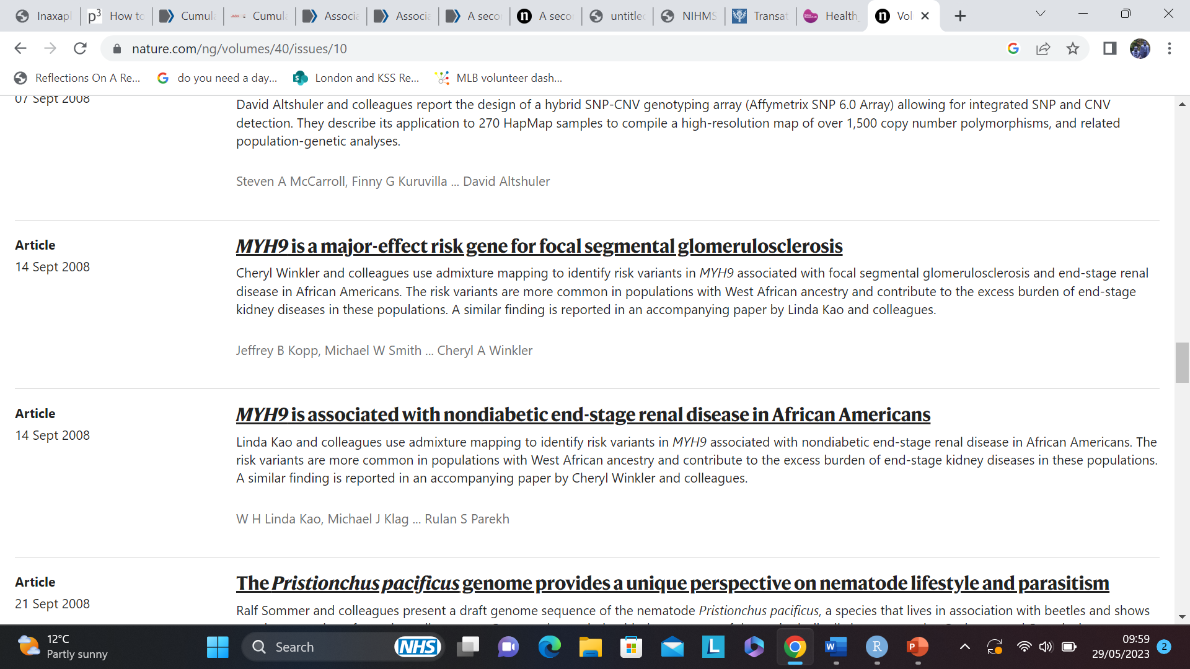
A Genetic Hope?

Slide 5
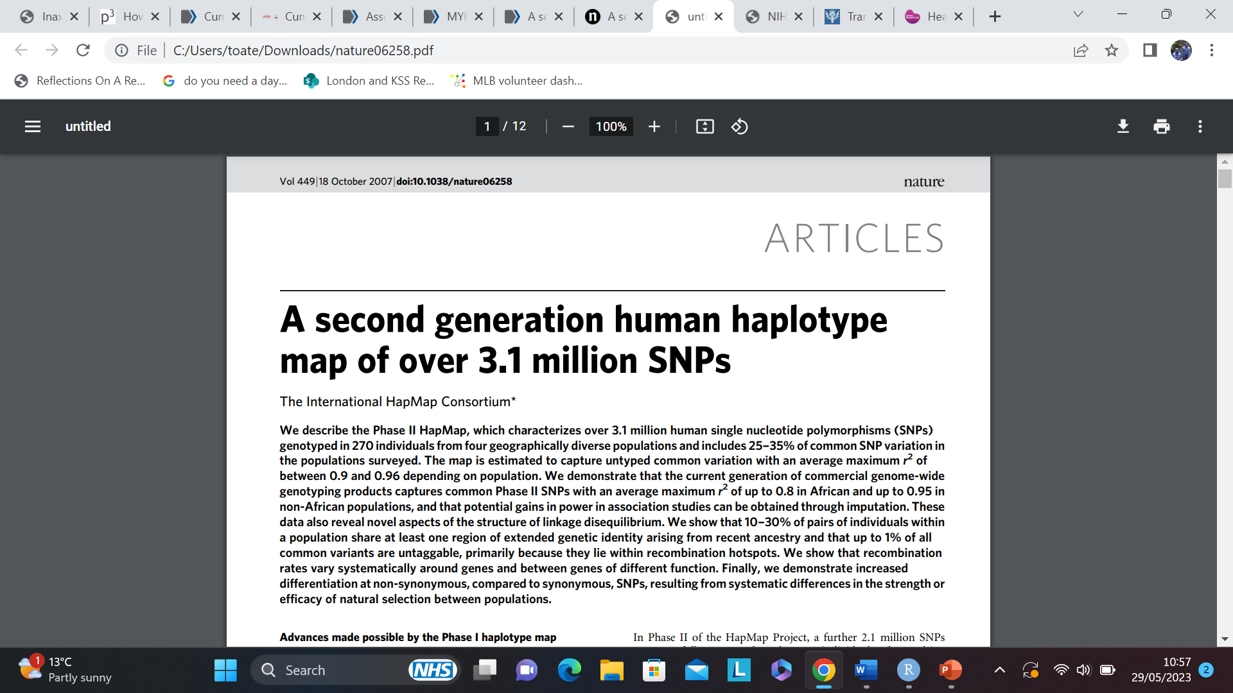
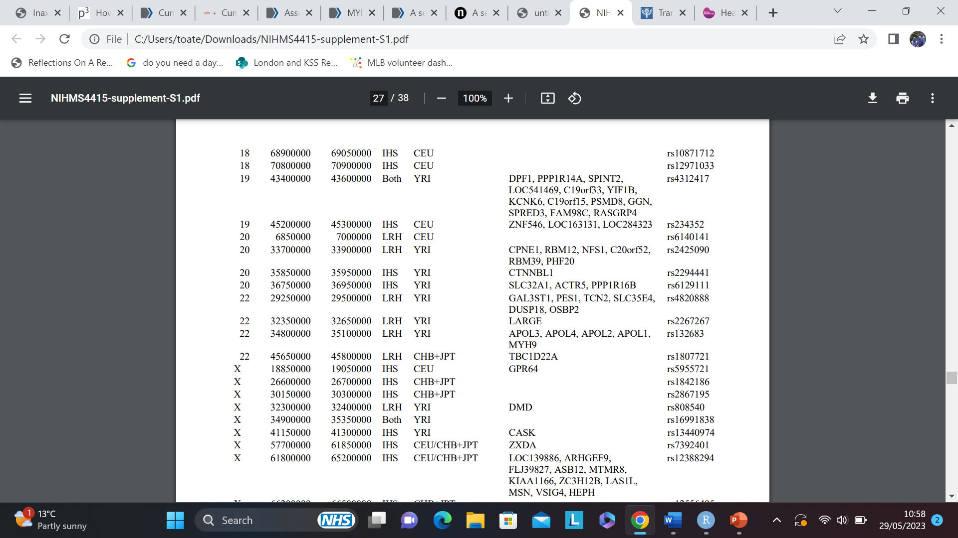
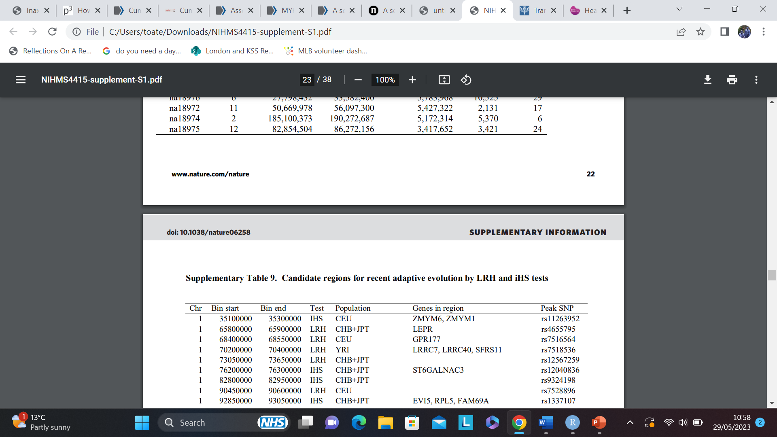
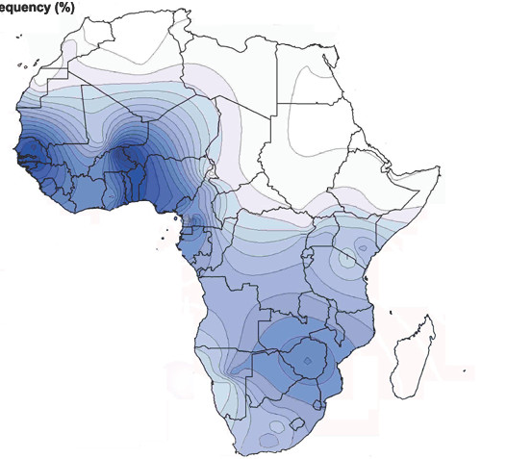
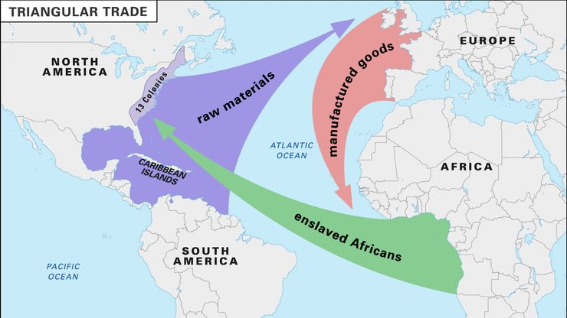
Shifting Focus

Slide 6
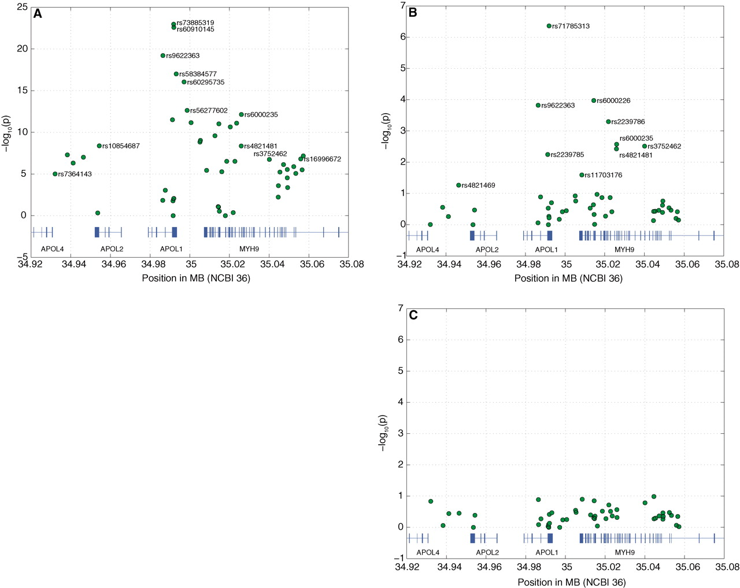
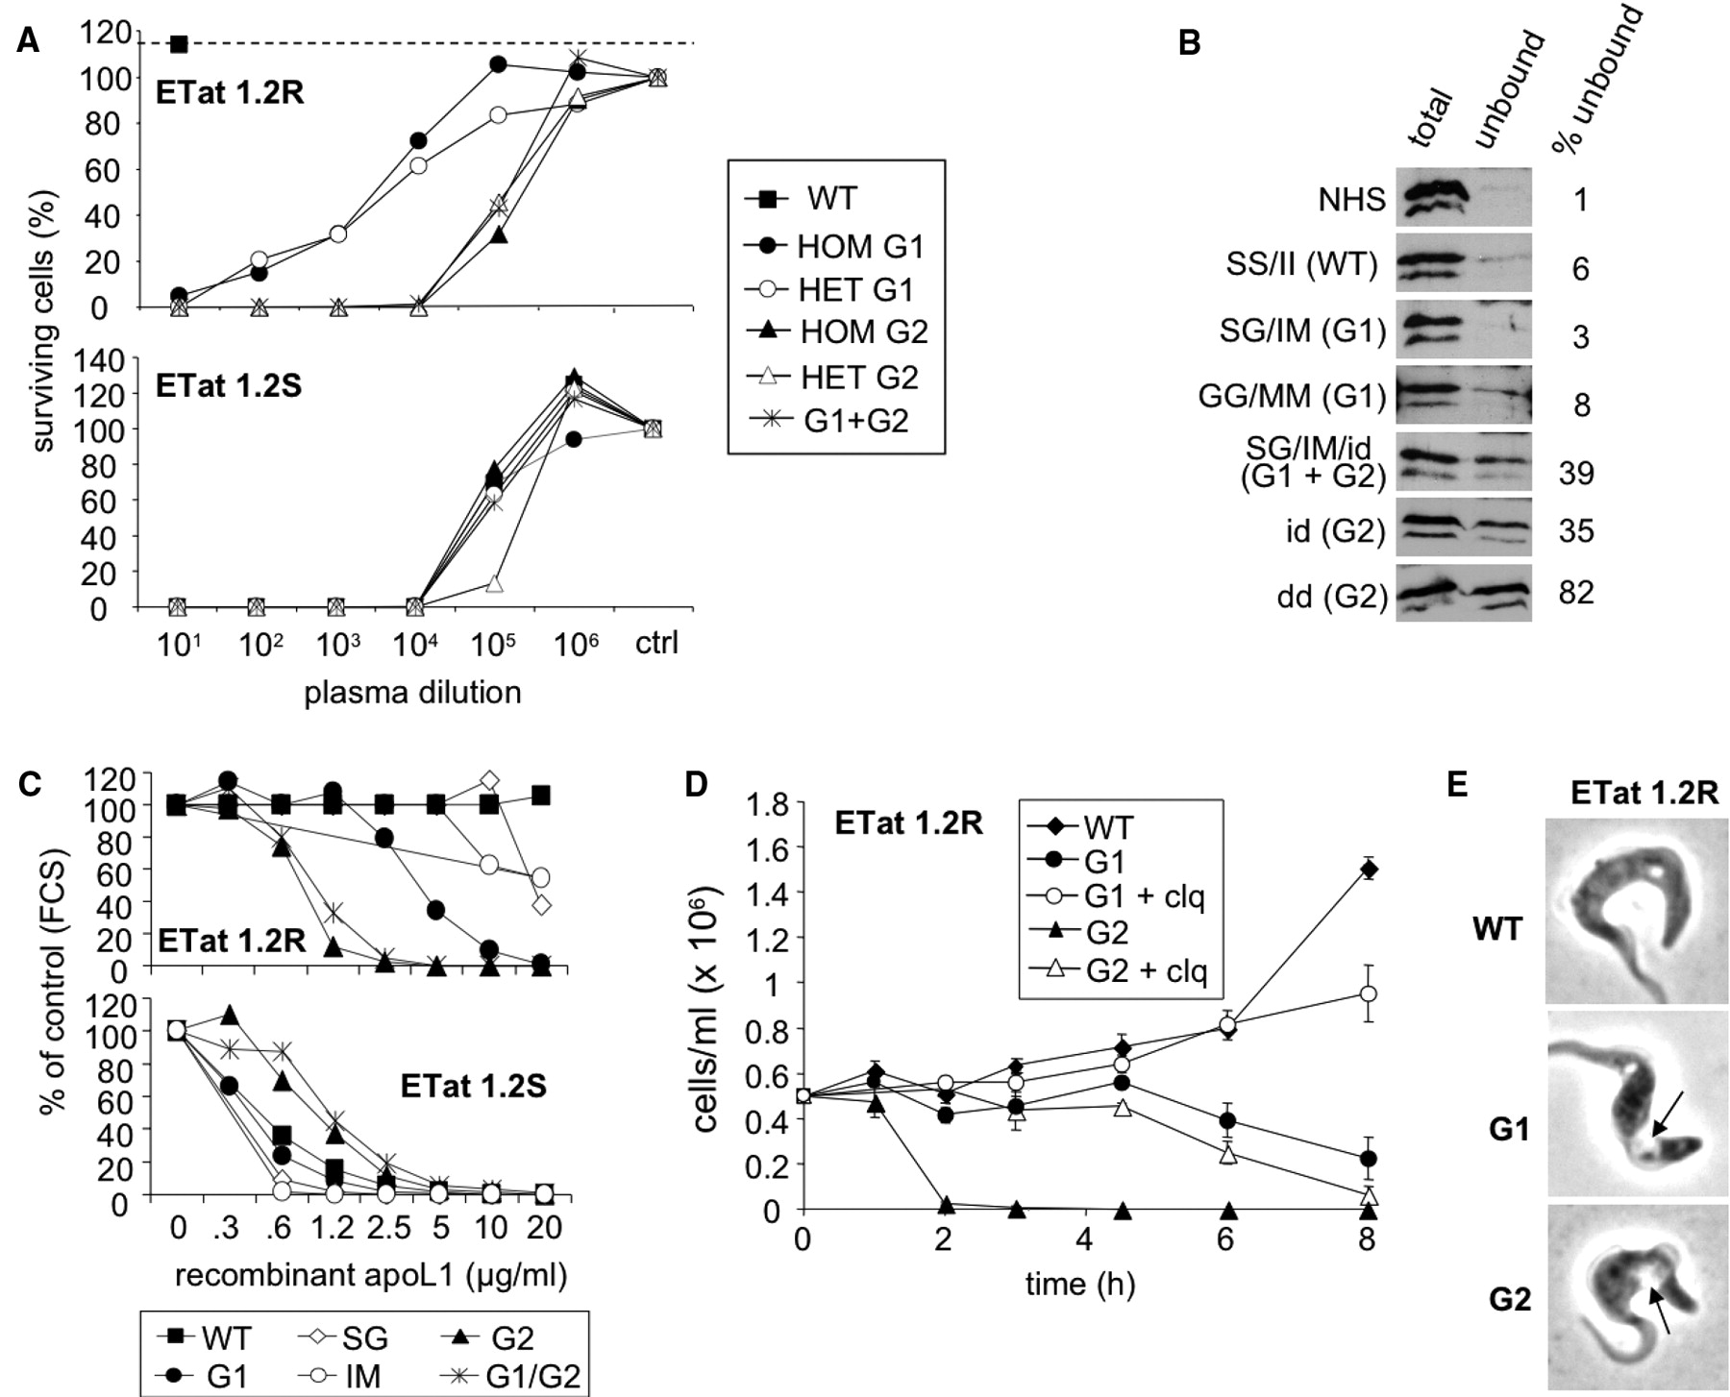
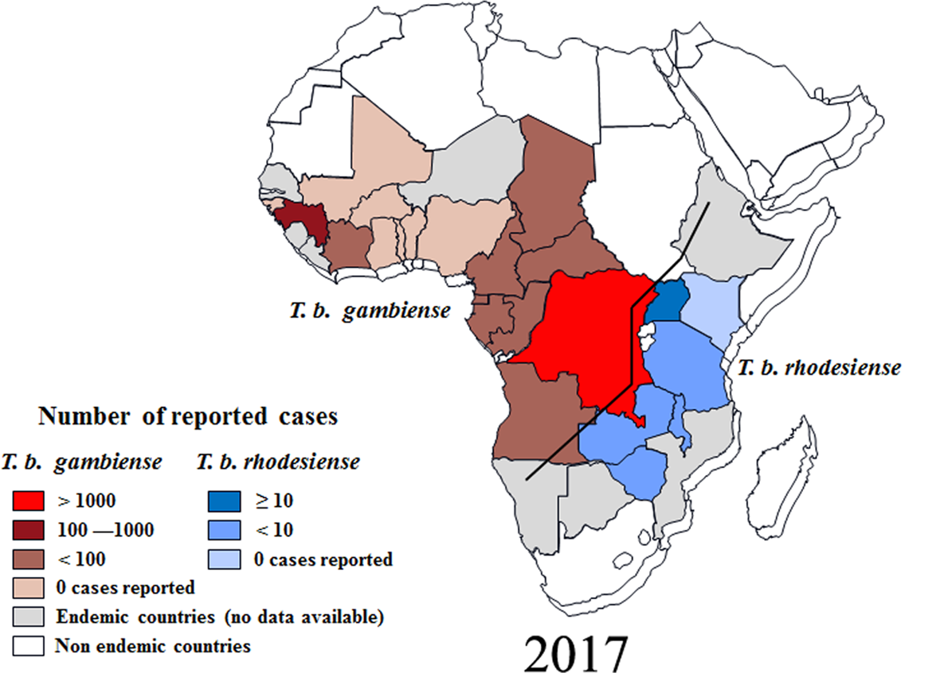
Natural Selection In Action
G1
G2
Genovese et al., Science, 2010
Gao et al., Parasitology, 2020

Slide 8
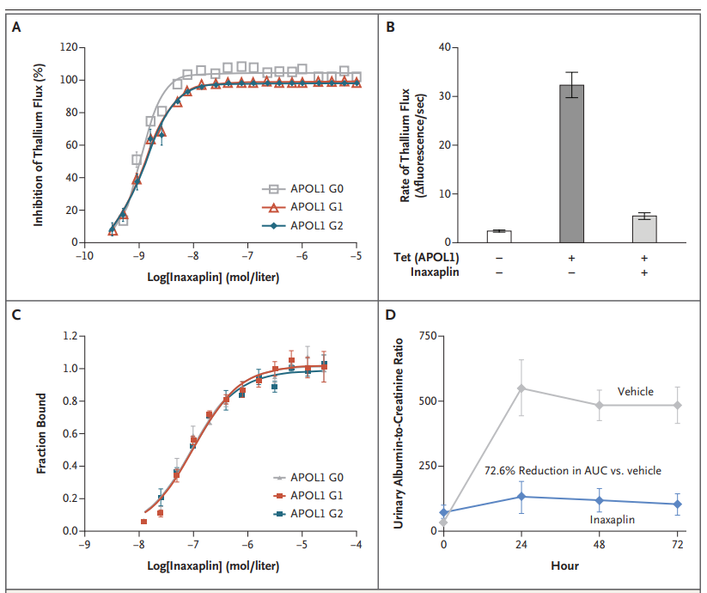
Pre Clinical Data
Ion flux is decreased by their drug in cells with risk alleles
You have to have APOL1 expression and the drug to reduce ion flux
Giving the drug to a mouse model significantly reduces proteinuria
The drug binds directly to APOL1 protein

Slide 9
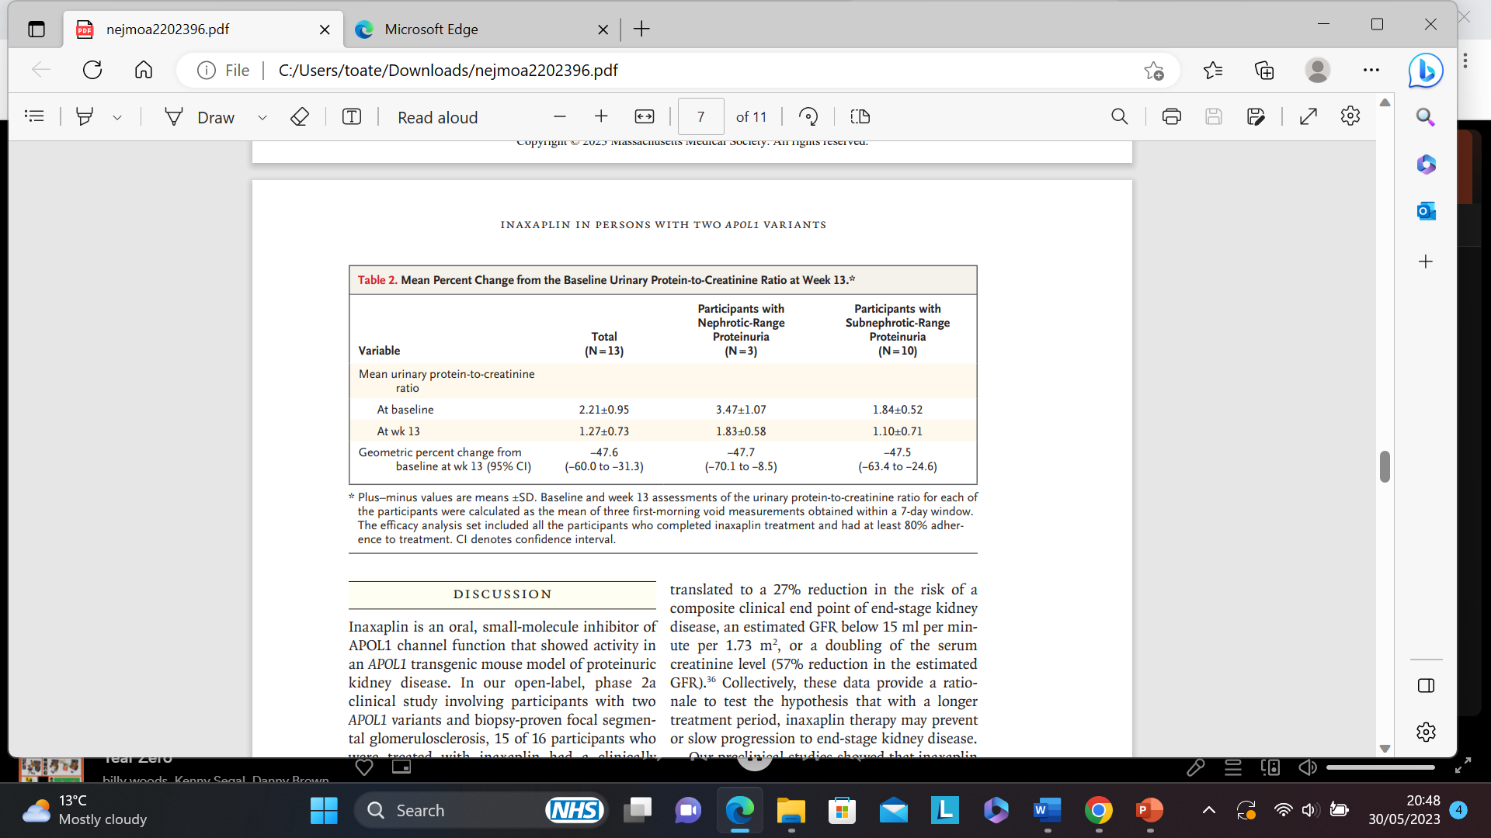
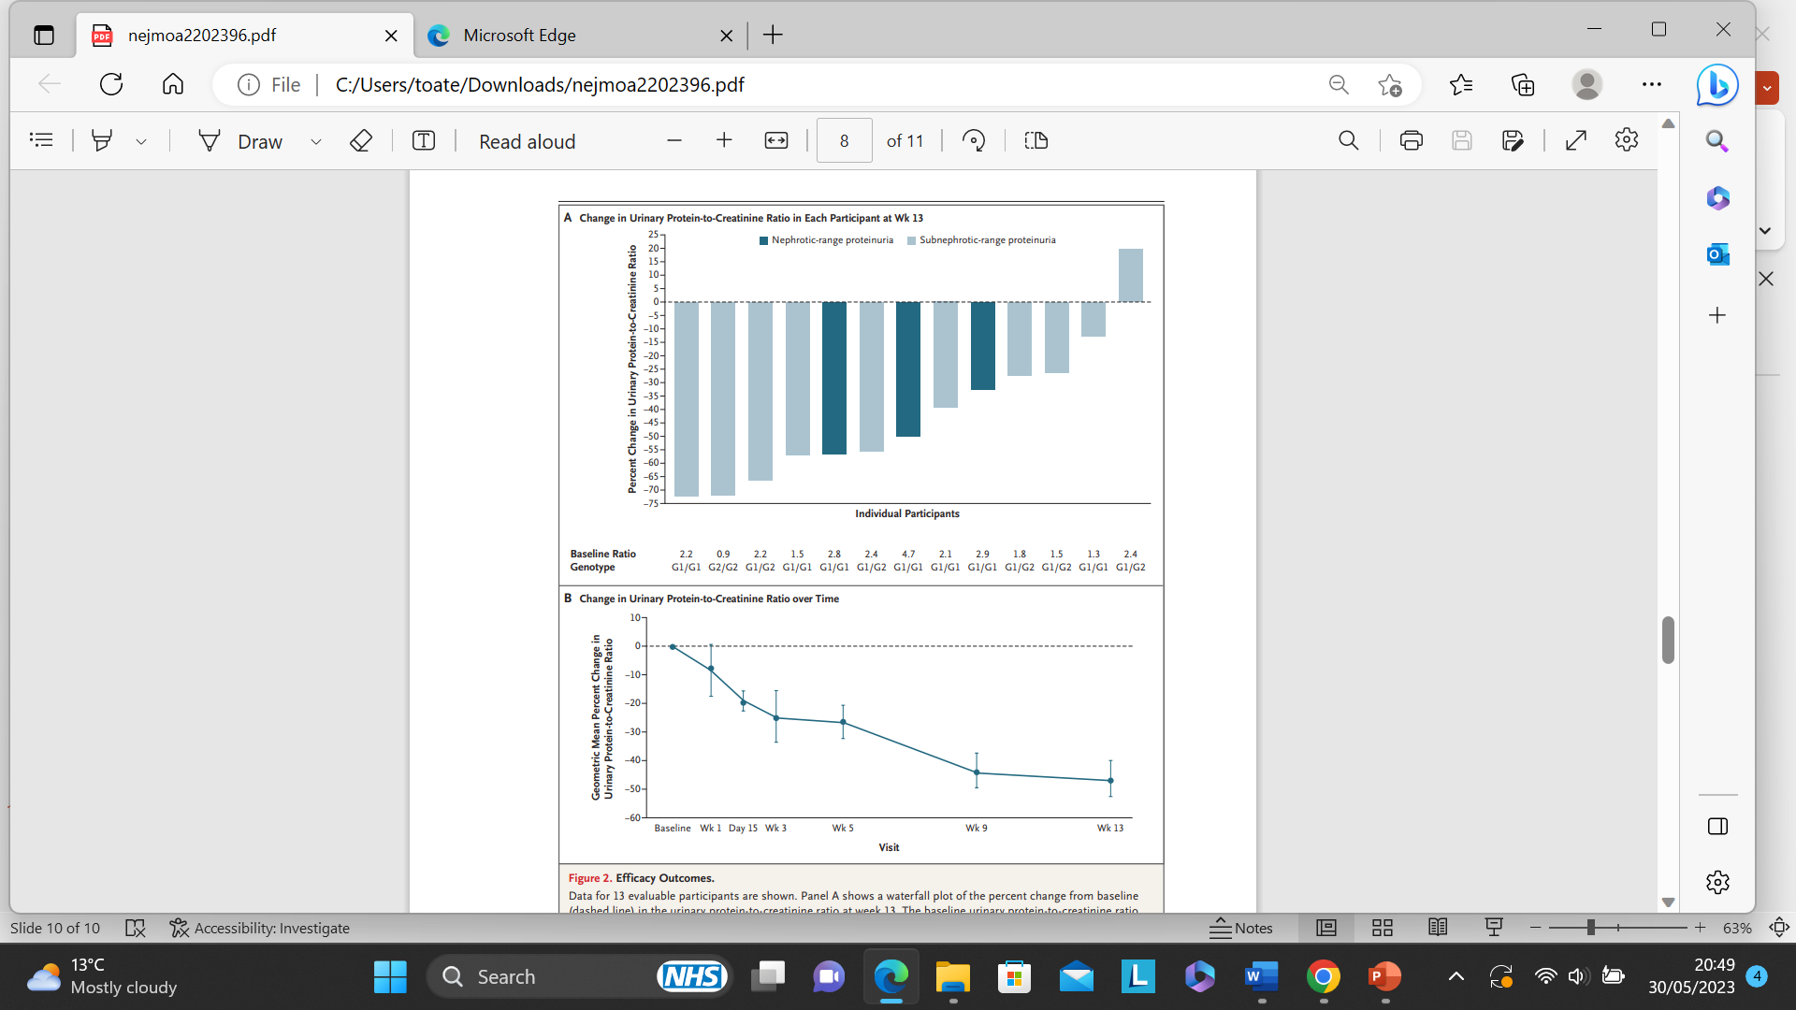
Clinical Data
Proteinuria mostly reduces over 13 weeks

Slide 10

APOL1
toates19@gmail.com

